Slide 1
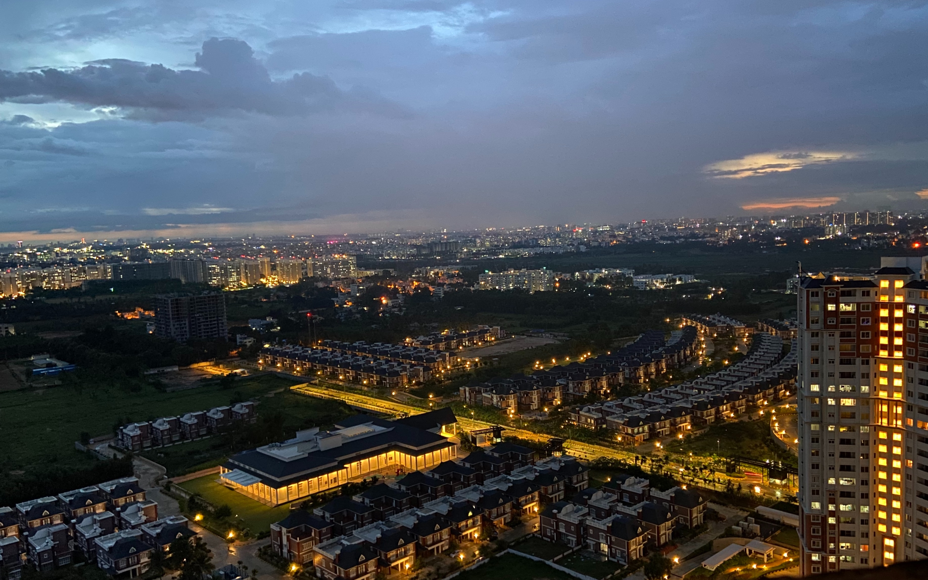
Coursera
Capstone
2021
Bengaluru
The
City of the IT
Hub
Author: Settara Pramod

Slide 2
IBM Data Science Capstone Bengaluru: The City of the IT Hub
Bengaluru is the capital and the largest city of the Indian state of Karnataka. It has a population of more than 8 million and a metropolitan population of around 11 million, making it the third most populous city and fifth most populous urban agglomeration in India. Located in southern India on the Deccan Plateau, at a height of over 900 m (3,000 ft) above sea level, Bangalore is known for its pleasant climate throughout the year. Its elevation is the highest among the major cities of India.

Slide 3
IBM Data Science Capstone Bengaluru: The City of the IT Hub
Bangalore is widely regarded as the "Silicon Valley of India" (or "IT capital of India") because of its role as the nation's leading information technology (IT) exporter. Indian technological organizations are headquartered in the city. A demographically diverse city, Bangalore is the second fastest-growing major metropolis in India. Recent estimates of the metro economy of its urban area have ranked Bangalore either the fourth- or fifth-most productive metro area of India. As of 2017, Bangalore was home to 7,700 millionaires and 8 billionaires with a total wealth of $320 billion.

Slide 4
IBM Data Science Capstone Bengaluru: The City of the IT Hub
It is home to many educational and research institutions. Numerous state-owned aerospace and defense organizations are located in the city. The city also houses the Kannada film industry. It was ranked the most livable Indian city with a population of over a million under the Ease of Living Index 2020.

Slide 5
Business Problem
The Questions which I aim to answer in this project are the following:
As the people doesn't know where to live or start to work in a country, I am representing in this report how to start and which colony is having all the resources such as utilities, groceries, gym, IT services etc. And one more thing:
1. Which is the good place to start?
2. Where we can we get all the resources as I mentioned above?
3. In the given neighborhood, is there any good rating services like online-ordering food is available?

Slide 6
Business Problem
I will try to answer the following questions:
1. Where is the good place to start in Bengaluru?
2. Where are the 'amenities' located?
3. Recent activities and Most common venues
4. Suggests the best place to start in Bengaluru.

Slide 7
Data Used
Bangalore district pin code from the site (https://finkode.com/ka/bangalore.html)
After using the geocoding API, we will create latitudes and longitudes for the given addresses.
Foursquare API Data:
We will need data about different venues in different neighborhoods of that specific borough. In order to gain that information we will use "Foursquare" locational information. Foursquare is a location data provider with information about all manner of venues and events within an area of interest. Such information includes venue names, locations, menus and even photos. As such, the foursquare location platform will be used as the sole data source since all the stated required information can be obtained through the API.

Slide 8
Methodology
First, we scrape the data using BeautifulSoup.
Second, we find the latitudes and longitudes of the given addresses(using Gmaps geocoding API)
Third, we will plot those coordinates using the folium map.
Fourth, We will find the number of collisions in the given dataset.
Fifth, Using the dataset, we will use FourSquare API for finding the places resided near to those pin codes and merge with the original dataset
Sixth, To use this dataset for predicting the most common venue, we have to use one-hot encoding for K-means Clustering algorithm.
Seventh, Using the silhouette score, we will find the best K-value for our most common venue prediction.
At last, Using the K-value, we will find the cluster labels for each an every place and last we will plot the map and find the most common venue point in the selective district.

Slide 9
Thank You

